Slide 1



Strat. Consultancy Project I & Data Analytics
MT5125 | MSc in Business Administration | 2020/2021
Dr. Damien Dupré
damien.dupre@dcu.ie
Assistant Professor - Business Research Methods

Slide 2
Tableau Workshop

Slide 3
Install and LOGIN

Slide 4
Install & Login
Download and install Tableau Desktop:
https://www.tableau.com/tft/activation
On the form, enter your school email address for Business E-mail and enter the name of your school for Organization
Activate with your product key:
TC9X-2E66-BDB0-D87C-EDFE

Slide 5
Dataset

Slide 6
Dataset: Titanic.csv
This data set provides information on the fate of the 1309 passengers on the fatal maiden voyage of the ocean liner ‘Titanic’ with their economic status (class), sex and age.
Description of the dataset:
Survival: Survival (0 = No, 1 = Yes)
Pclass: Ticket class (1 = 1st, 2 = 2nd, 3 = 3rd)
Sex: Male/Female
Age: Years
Sibsp: # of siblings / spouses aboard the Titanic
Parch: # of parents / children aboard the Titanic
Ticket: Ticket number
Fare: Passenger fare
Cabin: Cabin number
Embarked: Port of Embarkation (C = Cherbourg, Q = Queenstown, S = Southampton)

Slide 7
EXERCISES

Slide 8
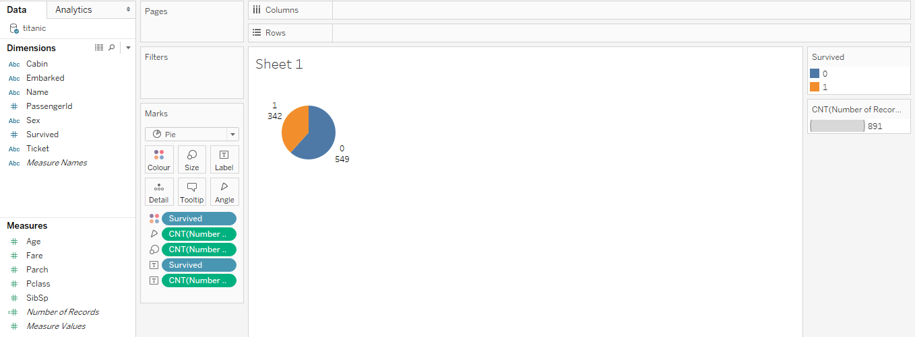
Ex 1: Pie Chart
Create a pie chart by counting the amount of passenger with the Survived variable

Slide 9
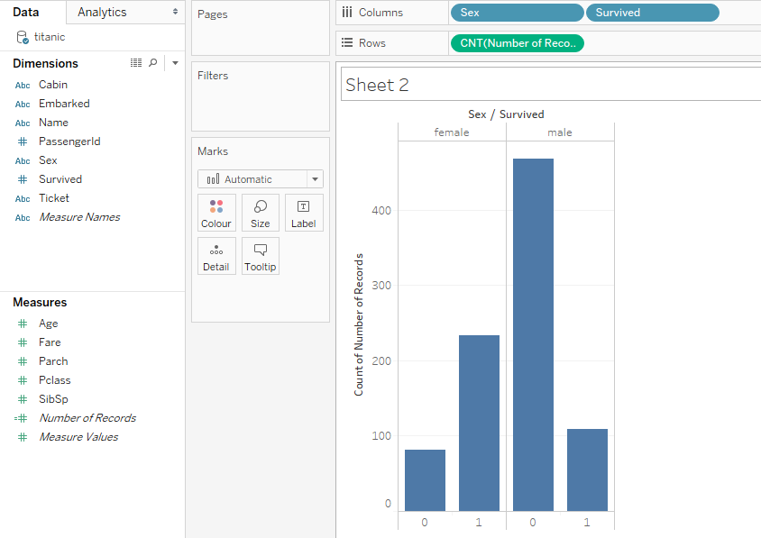
Ex 2: Bar Chart
Create a bar chart by counting the amount of passenger of with the Survived variable by Gender

Slide 10
Ex 3: Proportions
Create a bar chart or pie chart with the proportion of passenger from the Survived variable by Gender.
Solution:
Click on Analysis >
Percentage Of.
Select which of Table/ Row / Column / Pane is the most relevant for you

Slide 11
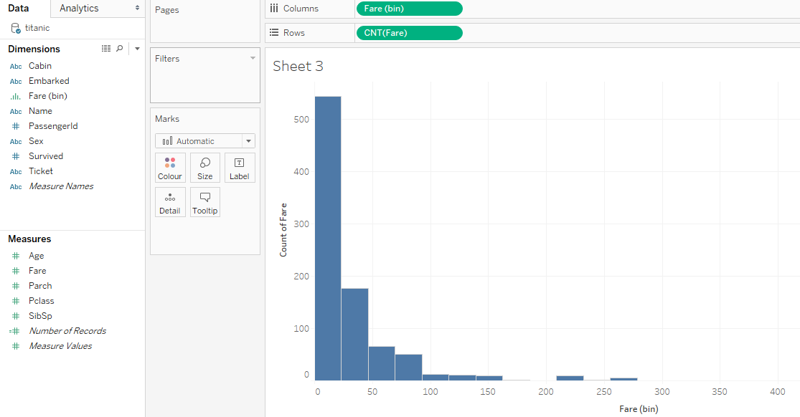
Ex 4: Histogram
Create an histogram of the Fare variable
Change the bin size by clicking on the new dimension called “Fare(bin)” and Edit size of bins.

Slide 12
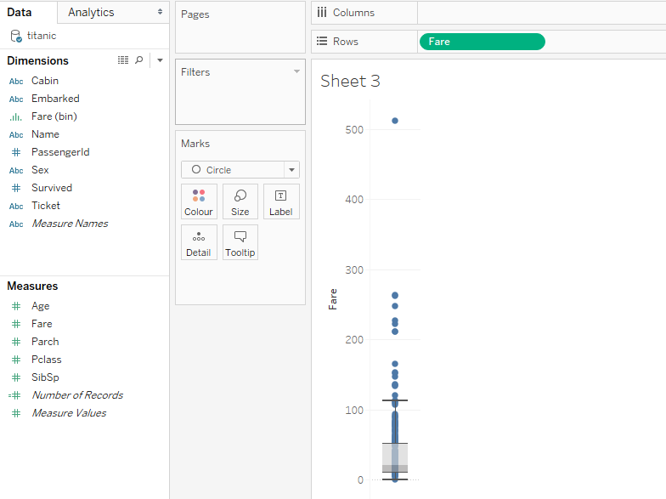
Ex 5: Box Plot
Create a box plot of the Fare measure by clicking on the variable and selecting Dimension

Slide 13
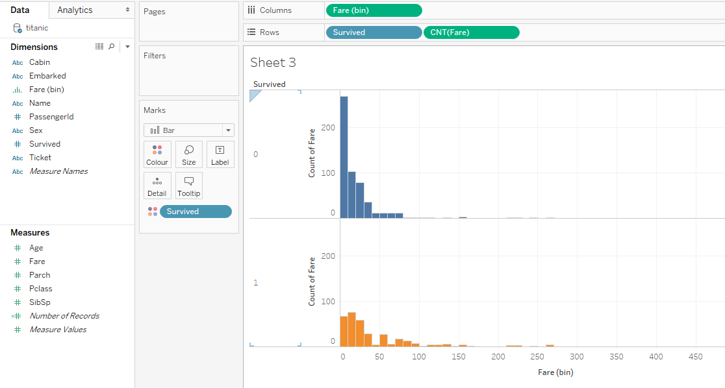
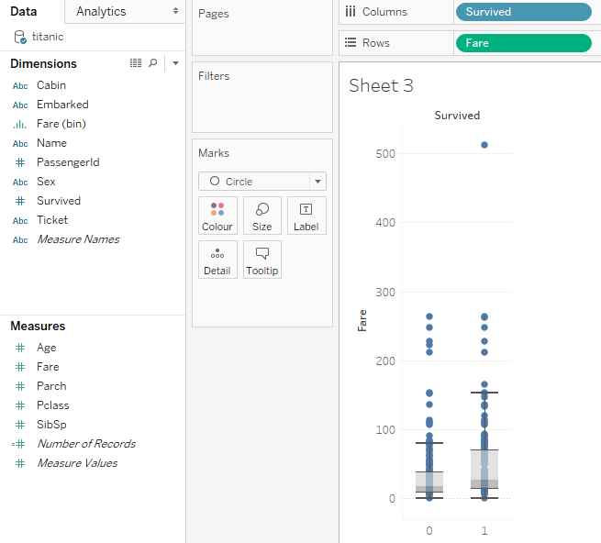
Ex 6: Histogram + Box Plot
Create an histogram plot of the Fare measure by Survived variable

Slide 14
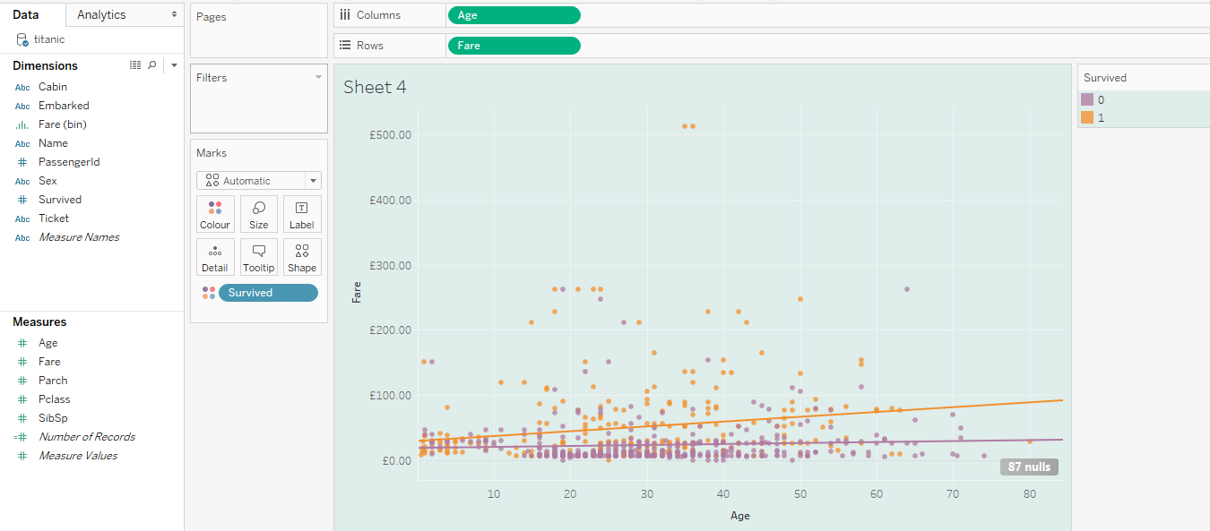
Ex 7: Scatterplot
Create a scatterplot of Fare by Age and split using the Survived variable

Slide 15
Ex 8: Dashboard
Create a Dashboard with the titanic dataset using figures that are new and/or already created
It has to tell a story:
Add a title
Add text boxes and pictures
Add legends
It has to be beautiful:
Change default colours
Customize shapes, interactive hovers ...

Slide 16
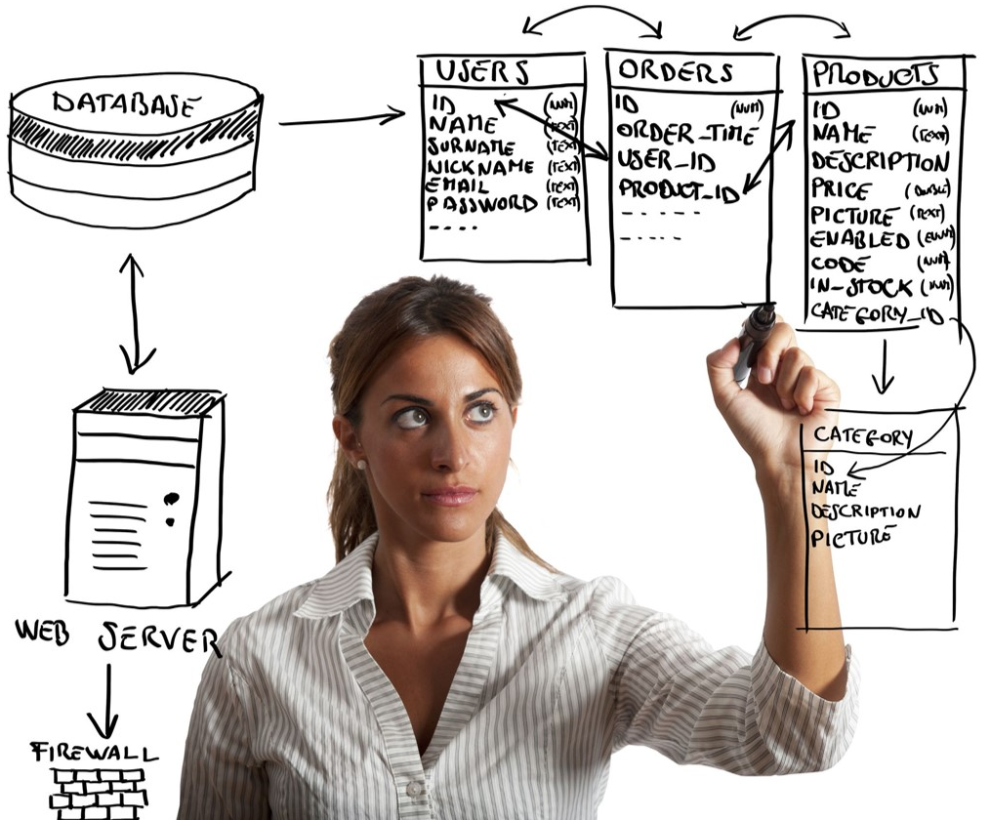
Questions?

